Slide 1
Snowflake Training

Slide 2
Agenda
Streams & Tasks
LAB
Dashboarding
LAB
LAB
Error handling and alerts
Directory Tables
Dynamic Tables
Cursor
Connect By
Day 5

Slide 3
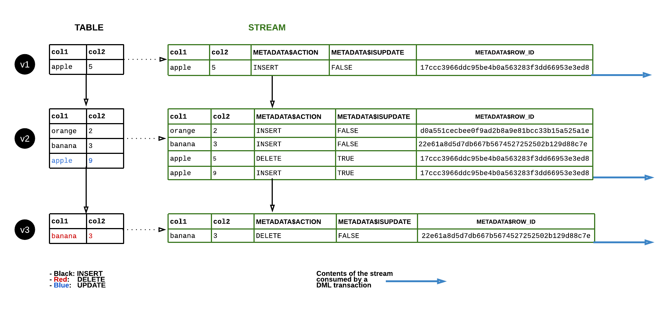
Example

Slide 4
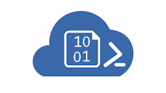
STREAMS & TASKS
Scheduled Task
Dependent Task
Dependent Task
LANDING Layer
STAGE Layer
Stream
DM Layer
STUDENT_LANDING
(truncate load)
STUDENT_STG
(Merge)
STUDENT_DIM
(scd 2)
Dependent Task
Analytical Layer
Archive
STUDENT
(truncate load)

Slide 5
LAB
Notes:
Show the impact of cloning of a schema that has a pipe configured on a table
Show that a share cannot be cloned

Slide 6
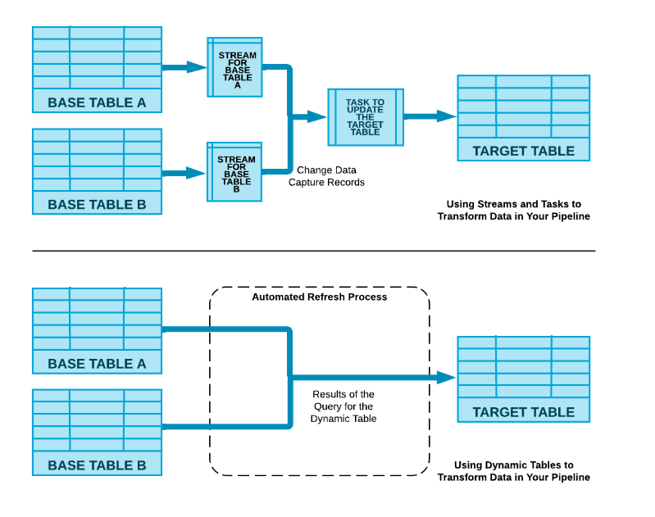
Streams & Tasks VS DYNAMIC Tables

Slide 7
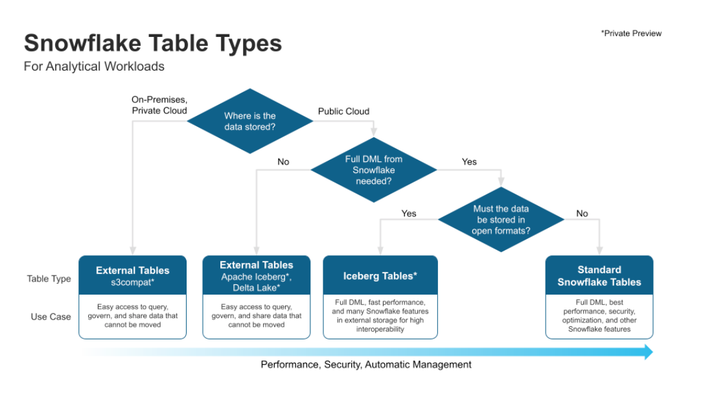
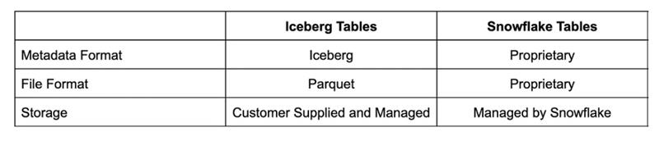
Iceberg table
Notes:
select get_ddl('table', 'mydb.public.salesorders’);
Temporary tables only exist within the session in which they were created and persist only for the remainder of the session.
This means you can create temporary and non-temporary tables with the same name within the same schema.
If the Time Travel retention period for a permanent table is set to 0, it will immediately enter the Fail-safe period when it is dropped.
Transient and temporary tables have no Fail-safe period.
Materialized views are automatically and transparently maintained by SnowflakeFor non-materialized views, the IS_SECURE column in the Information Schema and Account Usage views identifies whether a view is secure.
Snowflake does not allow standard DML (e.g. INSERT, UPDATE, DELETE) on materialized views. Snowflake does not allow users to truncate materialized views.

Slide 8
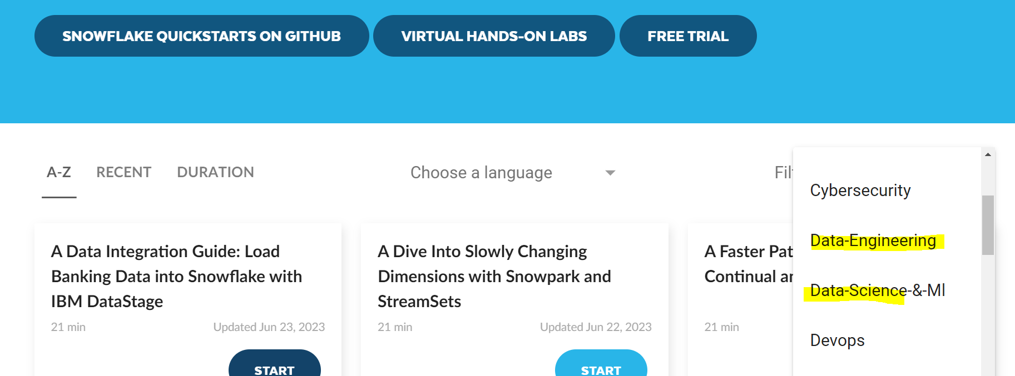
QuickStartS REF
https://quickstarts.snowflake.com/
Notes:
select get_ddl('table', 'mydb.public.salesorders’);
Temporary tables only exist within the session in which they were created and persist only for the remainder of the session.
This means you can create temporary and non-temporary tables with the same name within the same schema.
If the Time Travel retention period for a permanent table is set to 0, it will immediately enter the Fail-safe period when it is dropped.
Transient and temporary tables have no Fail-safe period.
Materialized views are automatically and transparently maintained by SnowflakeFor non-materialized views, the IS_SECURE column in the Information Schema and Account Usage views identifies whether a view is secure.
Snowflake does not allow standard DML (e.g. INSERT, UPDATE, DELETE) on materialized views. Snowflake does not allow users to truncate materialized views.

Slide 9
Thank You

